Slide 1
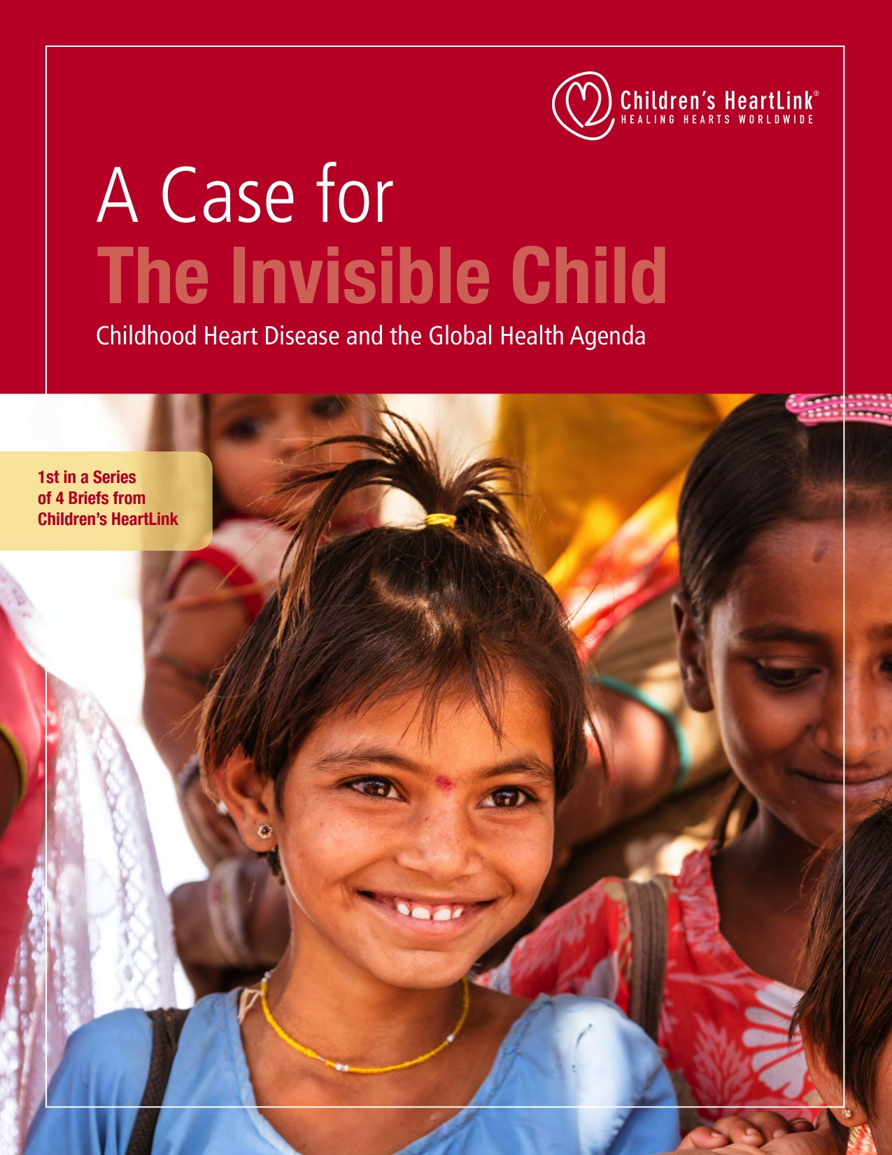
Notes:
Worldwide, one in 120 children are born with a congenital heart defect, and 90 percent of these children live where there is inadequate medical care.
Children’s HeartLink is a Minneapolis, Minnesota-based nonprofit humanitarian organization that is calling attention to the issue of lack of access to care through an advocacy project called The Invisible Child.
To save the lives of children with heart disease, Children’s HeartLink partners with organizations to train medical teams, provide education and transform health care in underserved parts of the world.
Children’s HeartLink partners with medical volunteer teams from some of the finest institutions in the world to empower their peers in the countries where it works.
When the local programs advance and deliver consistently excellent pediatric cardiac care, they begin training others in their part of the world.
Last year alone over 1,200 medical professionals received training, and over 80,000 children were served at Children’s HeartLink’s partner hospitals. Children’s HeartLink is putting out a series of issue briefs over a 2-year period called The Invisible Child: Childhood Heart Disease and The Global Health Agenda.
The first brief in the series, which makes a case for the invisible child.
Families are rising out of poverty.
Communicable childhood diseases are diminishing.
And health systems are modernizing.
Children’s HeartLink is committed to ensuring that health systems and governments are prepared to identify and care for children with heart disease.
These briefs are all available for download on Children’s HeartLink’s website at theinvisiblechild.childrensheartlink.org

Slide 2
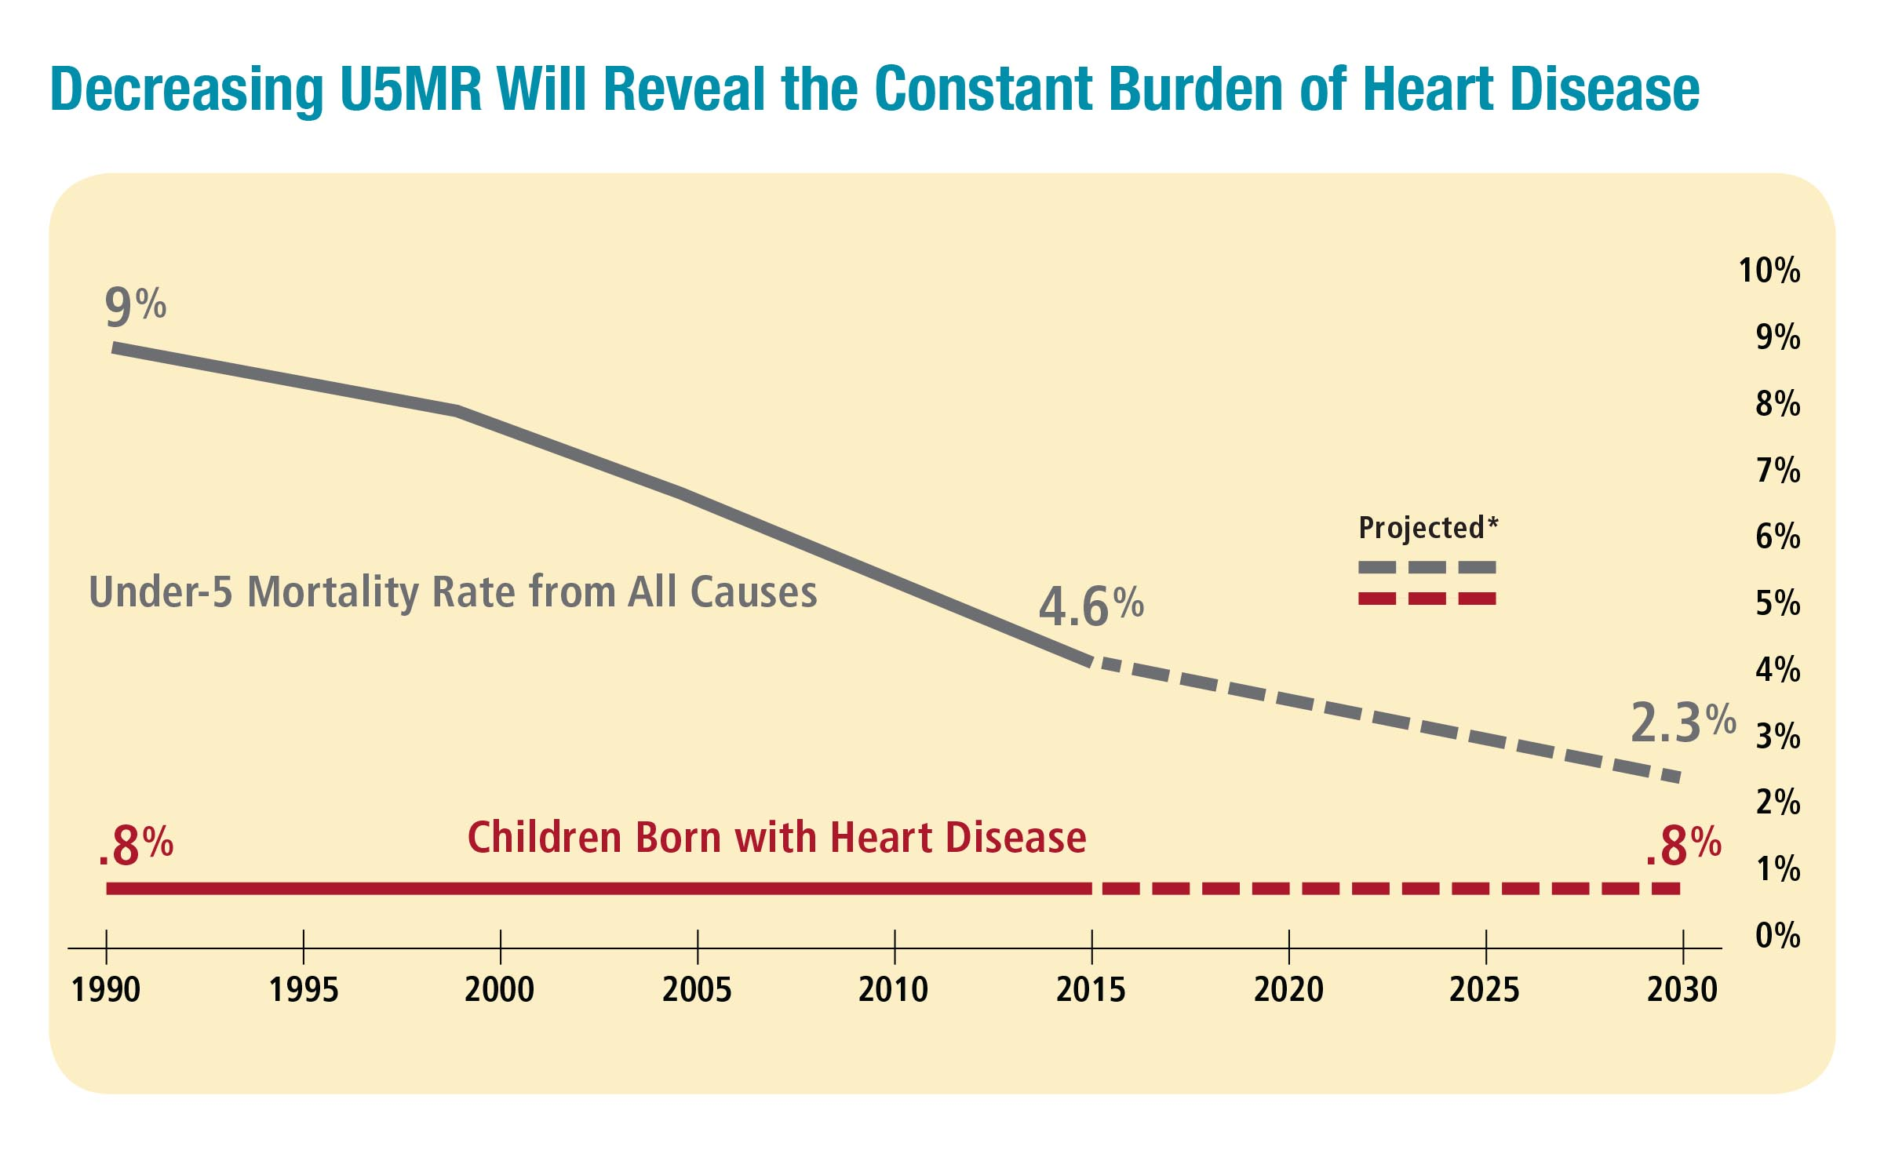
Notes:
This slide shows the stark reality of the global burden of disease in children.
As more countries have a growing middle class, the under-5 mortality rates from poverty-related diseases like tuberculosis and malaria decline.
When this happens, it reveals the other major causes of child deaths, such as congenital heart disease, for which the incidence is constant worldwide.

Slide 3
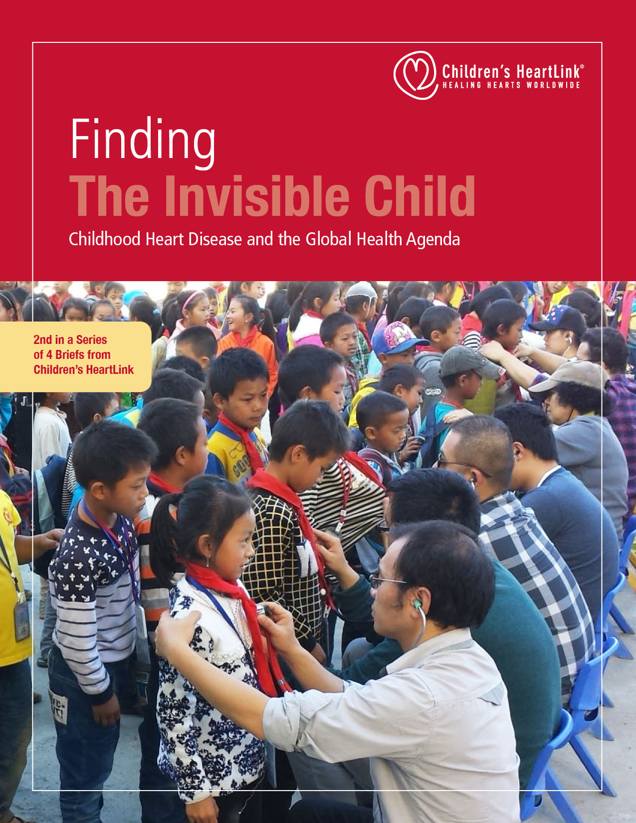
Notes:
The second brief in the series addresses access.
One million children are born every year with heart disease.
Only 25 percent of these children live in areas with reliable access to quality care.
Even this number hides the skew toward urban centers in developed countries.
Access to care overall is paramount in the global health agenda.
Improved awareness of the needs of children with heart disease in the primary health care setting will improve the lives of many.

Slide 4
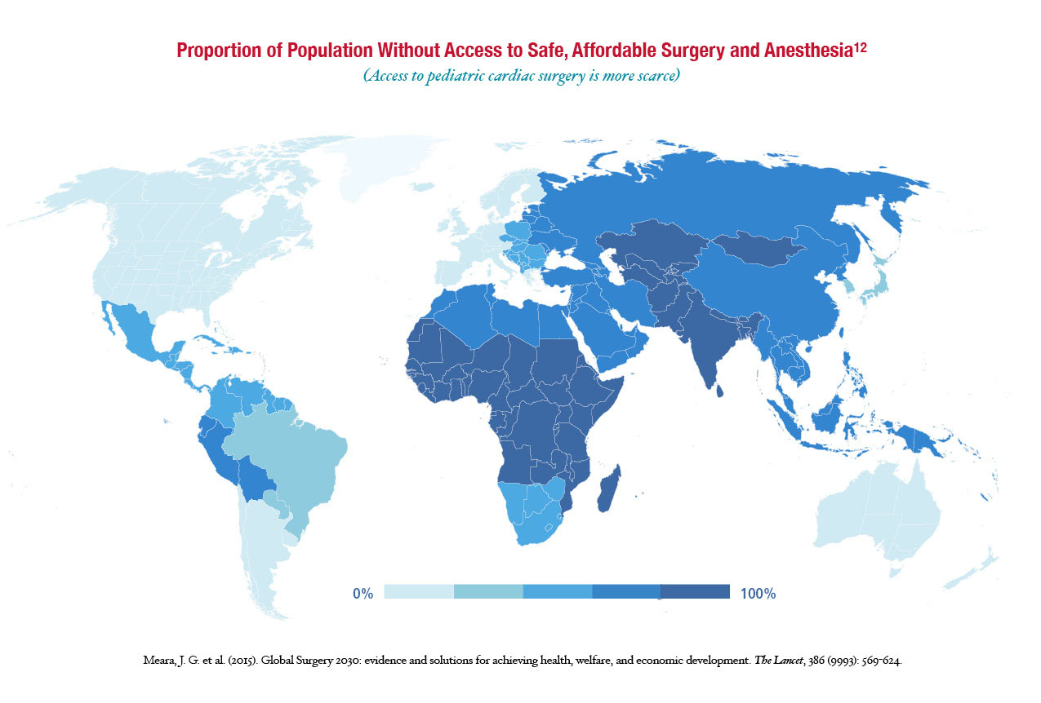
Notes:
Only 7 percent of the population in developing countries has access to congenital heart disease surgery, leaving backlogs of millions of children awaiting lifesaving surgery.
In order to meet the surgical workforce needs within the framework of the UN Sustainable Development Goals, we will need to double the world’s current surgical workforce.
To care for children with heart disease It is essential to build a pediatric cardiac workforce.

Slide 5
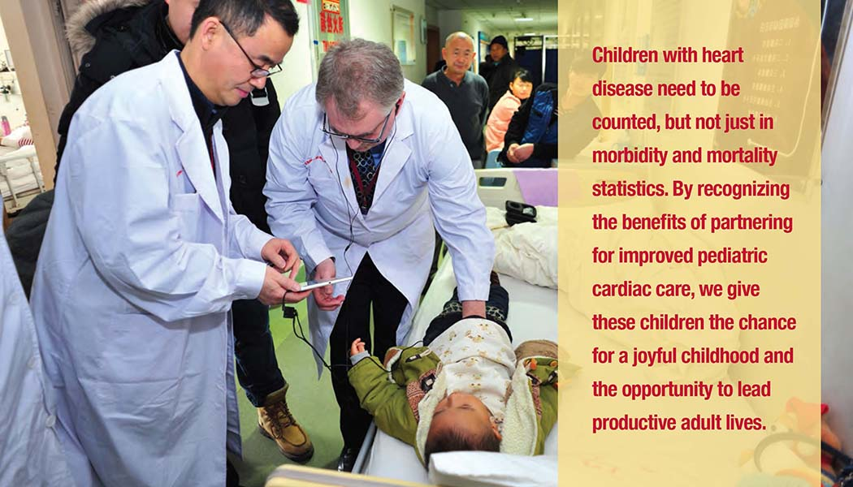
Notes:
To increase access to care we also need to close the data gap.
Surveillance of pediatric heart disease is not a simple undertaking and in most cases will require international support and coordination in the initial design and implementation phases.
But until we have data it is very difficult to scale-up treatment options for children with heart disease.
We need to know:
Incidence and prevalence
Treatment access and costs
Associated morbidity and mortality
And economic impact.
For this to happen, it’s important for physicians, nurses and midwives to have the knowledge and ability to diagnose heart disease in children—not only to refer for treatment where available, but to better understand the true causes of child illness and death.

Slide 6
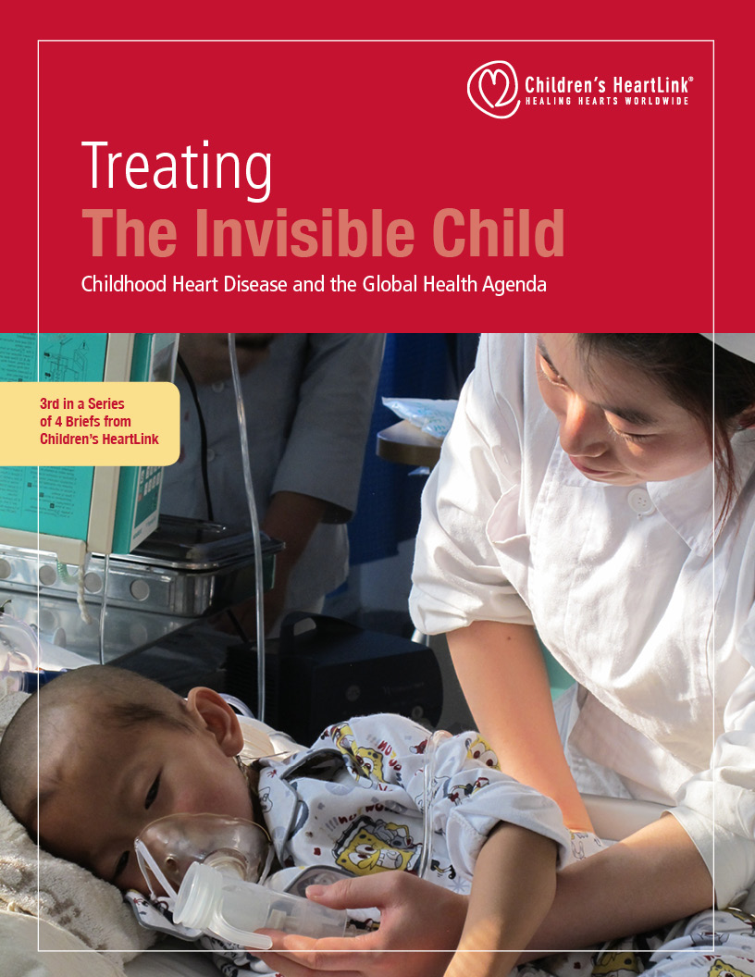
Notes:
The third brief addresses the importance of strengthening health systems.
Many countries are already secure in their ability to meet basic and emergency surgical needs.
For these countries it is time to invest in the surgical needs of the millions of children with heart disease.

Slide 7
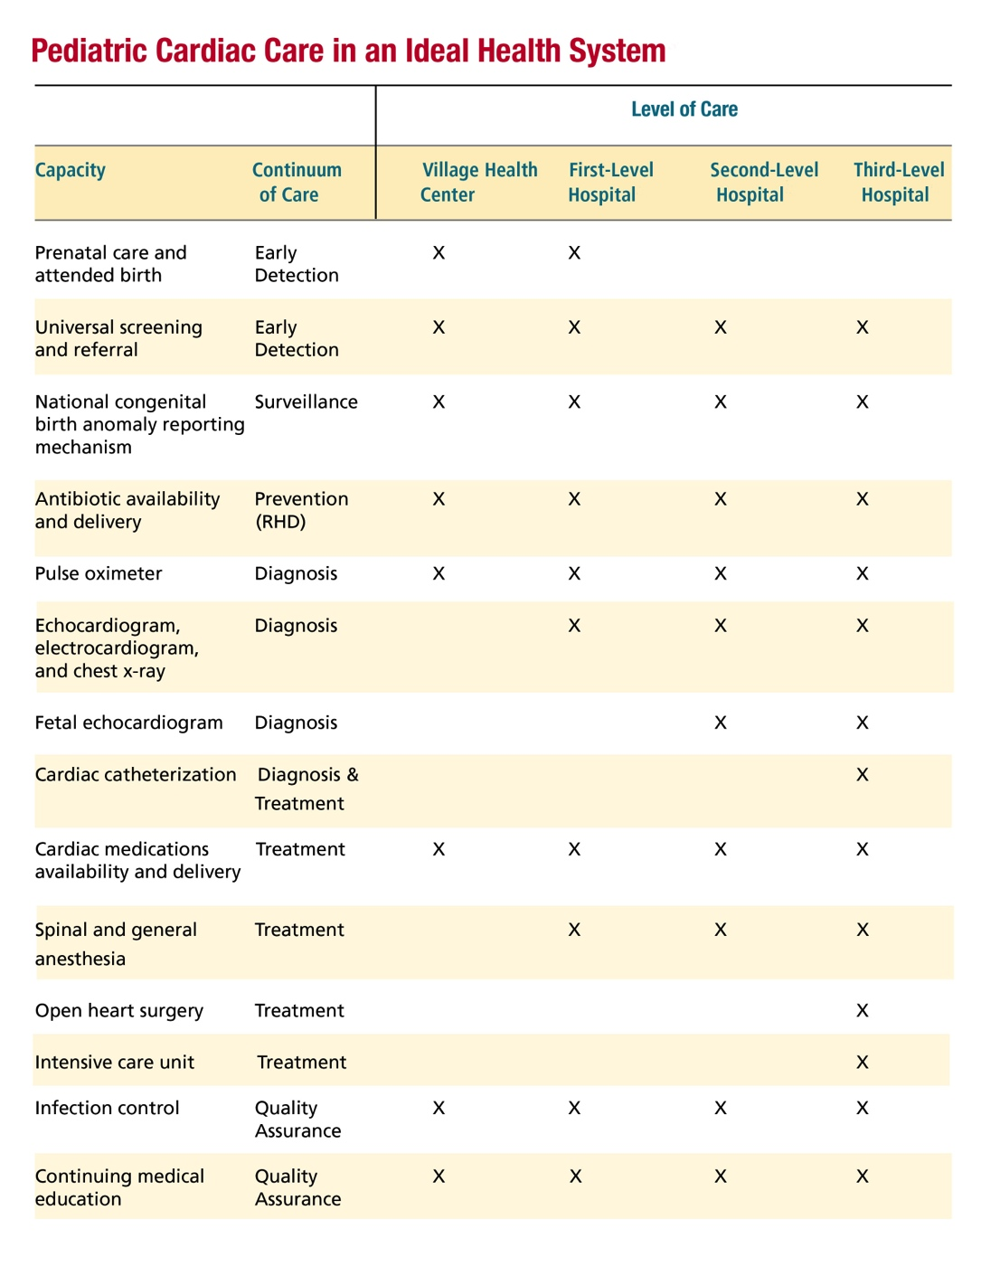
Notes:
Strong health systems are essential for treating children with heart disease.
To increase capacity to care for children with heart disease, we need to develop sustainable centers of excellence.
These are centers that deliver excellent care on a consistent basis and can then go on to become regional trainers.
This is the only way to begin making meaningful improvements in access to care.

Slide 8
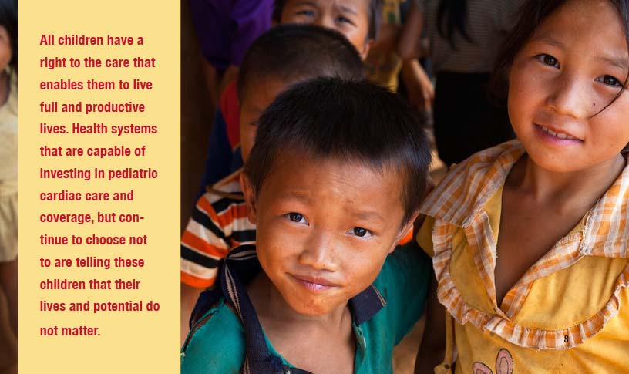
Notes:
We also need to finance pediatric cardiac care.
Based on Children’s HeartLink’s experience, it estimates that more than 40 current low- and middle-income countries will have the capacity to incorporate care for children with heart disease into their health systems by 2030.
Many congenital heart lesions can be treated with a relatively simple intervention.
But even in the few areas where this level of care is available, the financial cost to the family is generally unattainable.
In order to end preventable child deaths, high-income and developing countries, NGOs and philanthropic donors, must work collectively to close the access gap.
Pediatric cardiac care should be included in long-range surgical scale-up plans.
Children with congenital heart disease are already born with barriers to health—they should not also face barriers to care.

Slide 9
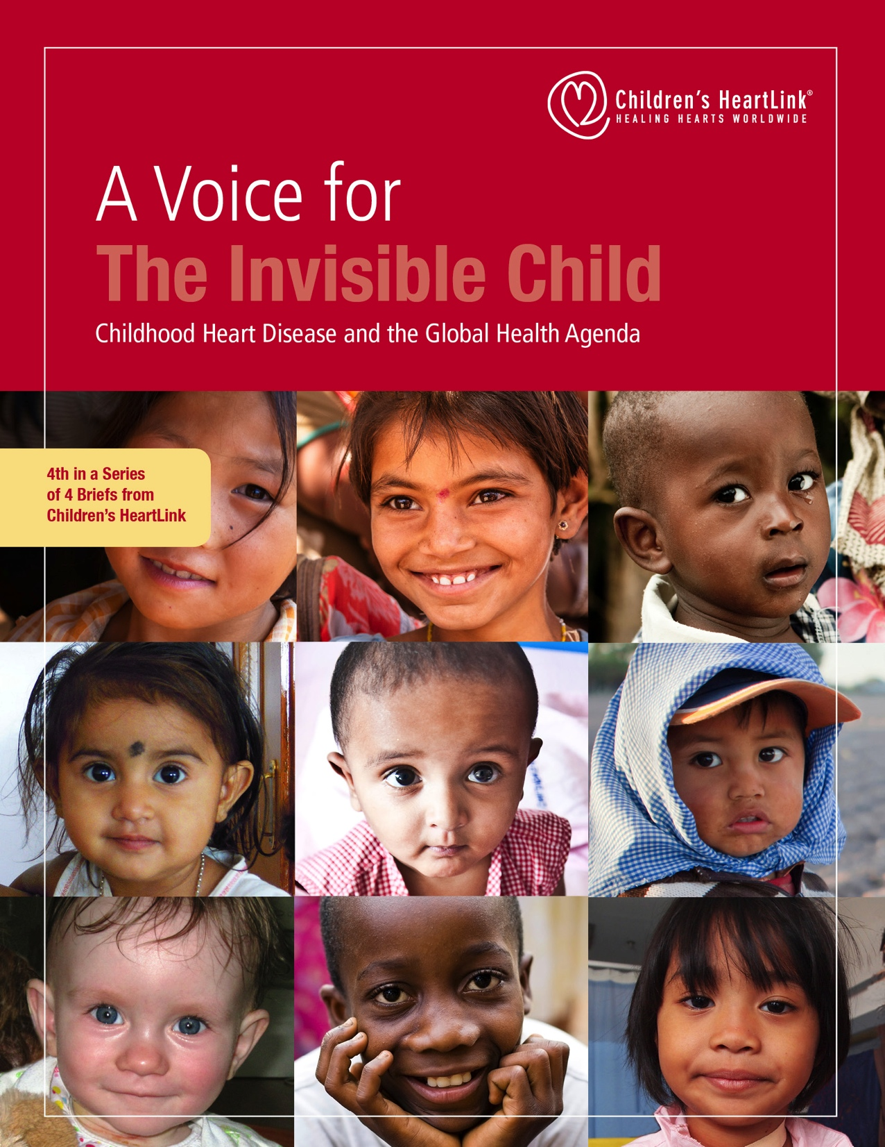
Notes:
The final brief in the series is the Call to Action.
Ending preventable child deaths is rightly among the ambitious of the UN Sustainable Development Goals.
Complex chronic and congenital pediatric diseases are among the conditions that require increased and sustained attention from the global health and development communities.
With this Call to Action, Children’s HeartLink calls on all of us to leverage the unique strengths of our respective organizations to increase sustainable and equitable access to pediatric cardiac care across the world.

Slide 10
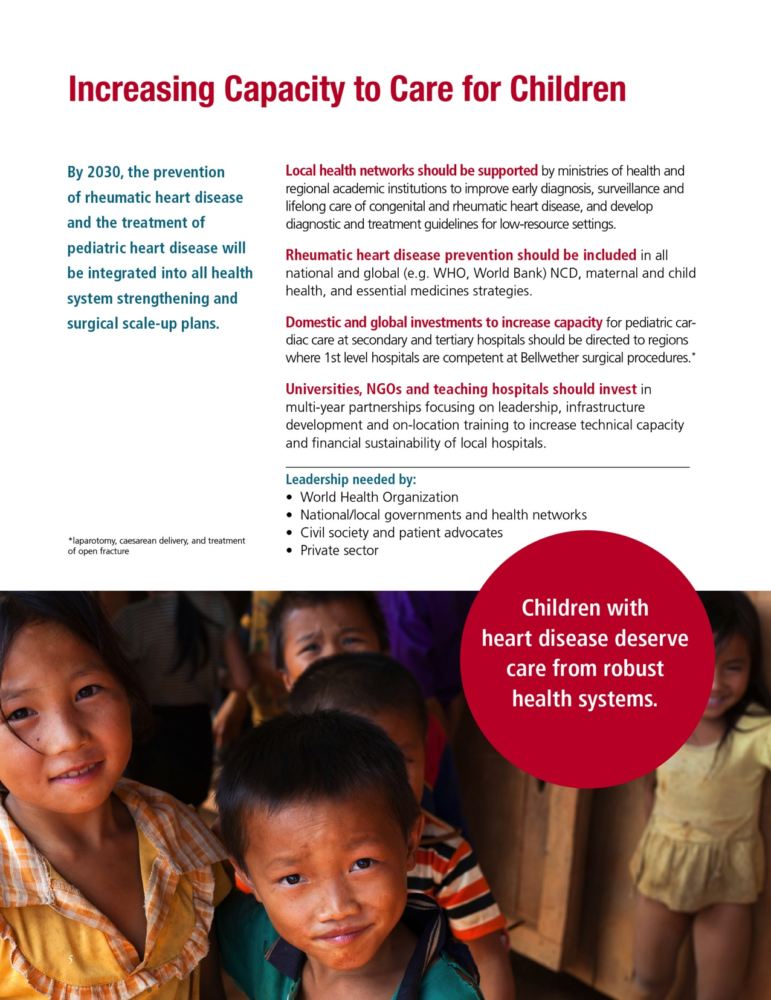
Notes:
Caring for children is a universal goal.
Here is Children’s HeartLink’s vision for caring for children with heart disease.
We need to increase the capacity to care for children with heart disease by strengthening health systems.

Slide 11
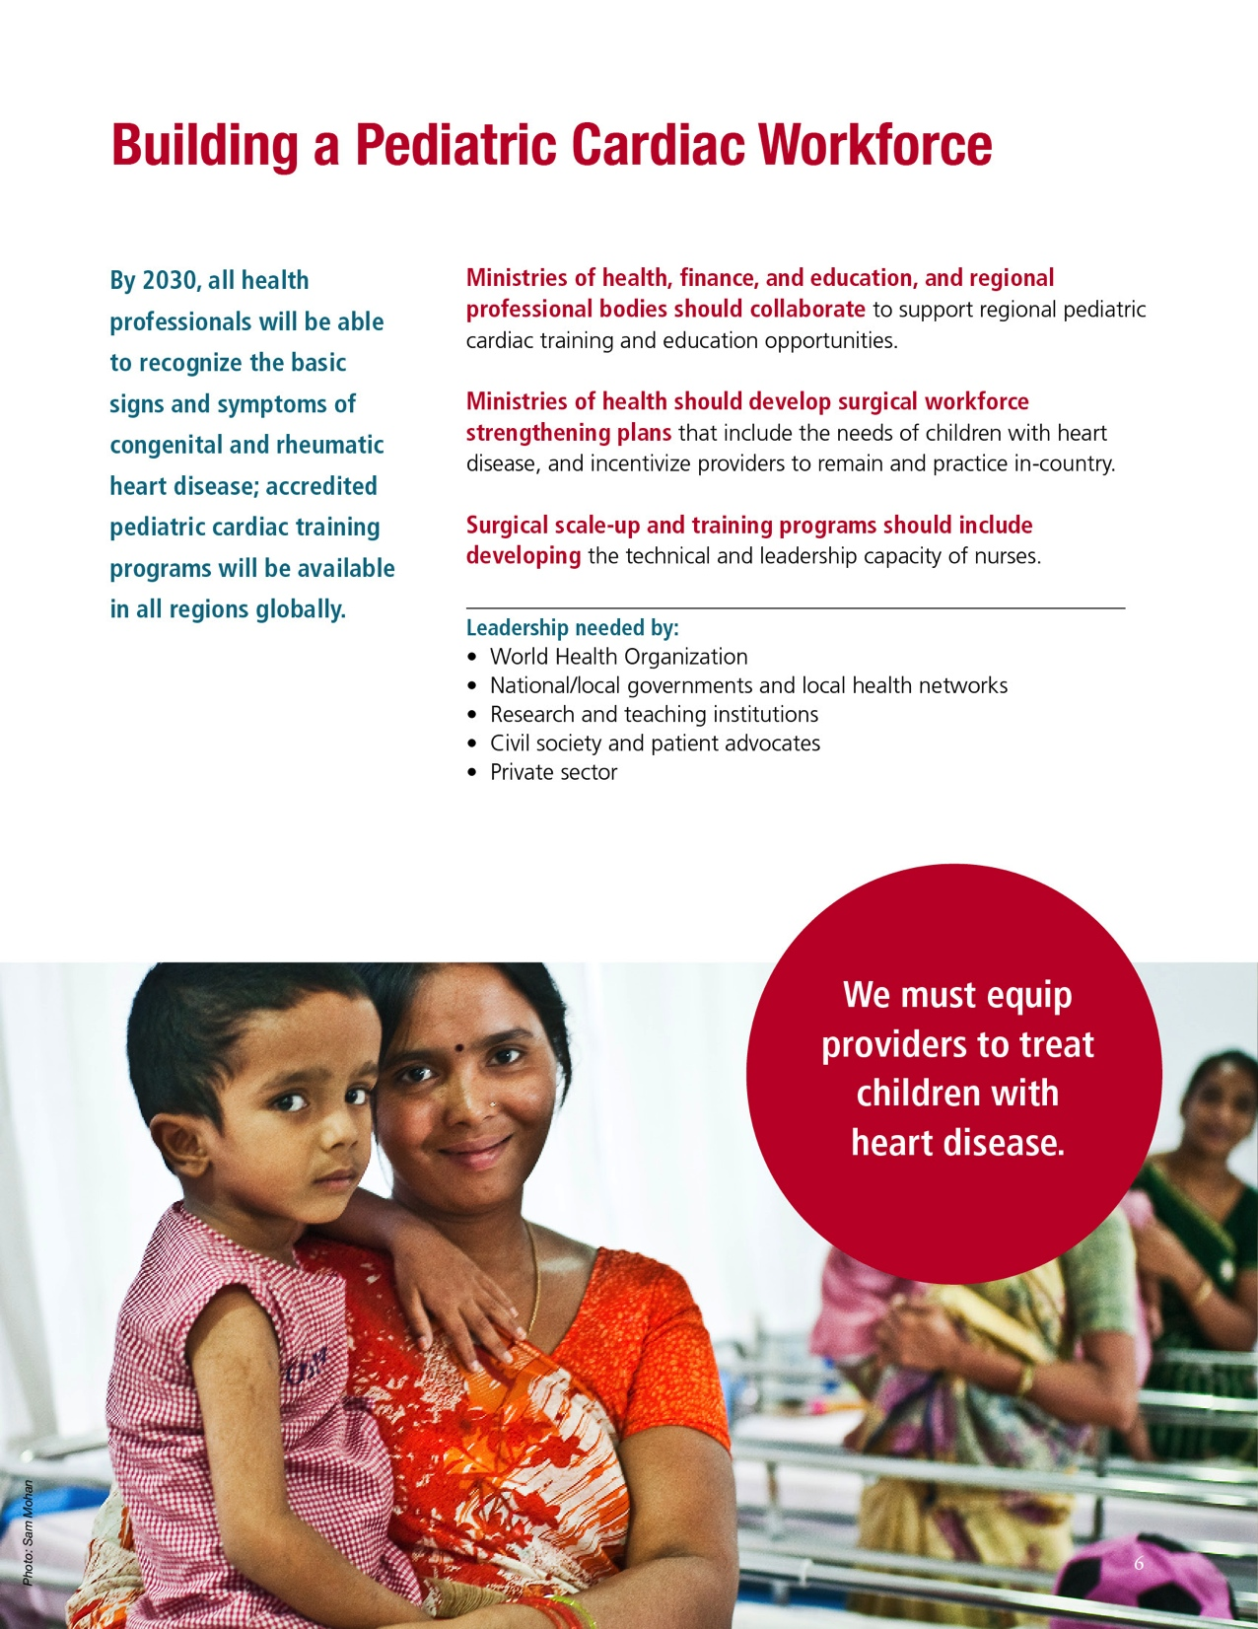
Notes:
We need to build a trained pediatric cardiac workforce to diagnose and treat children with heart disease.

Slide 12
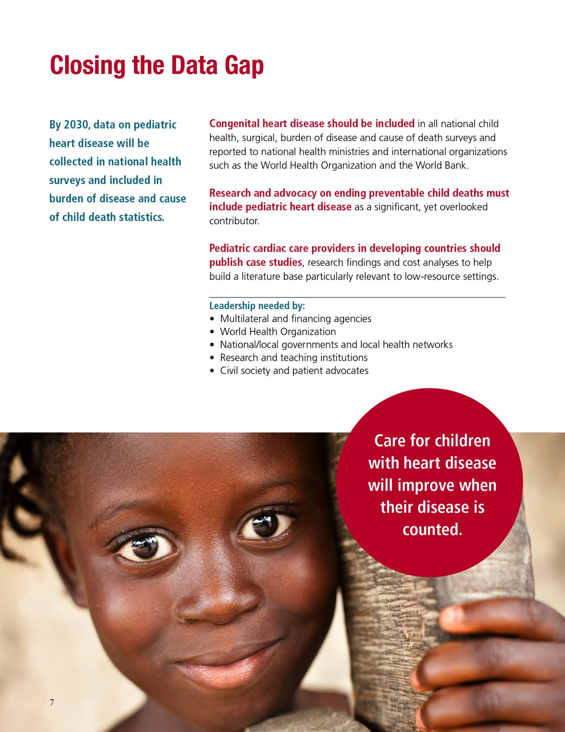
Notes:
We need more and better data about children with heart disease, because “what gets measured gets done.”

Slide 13
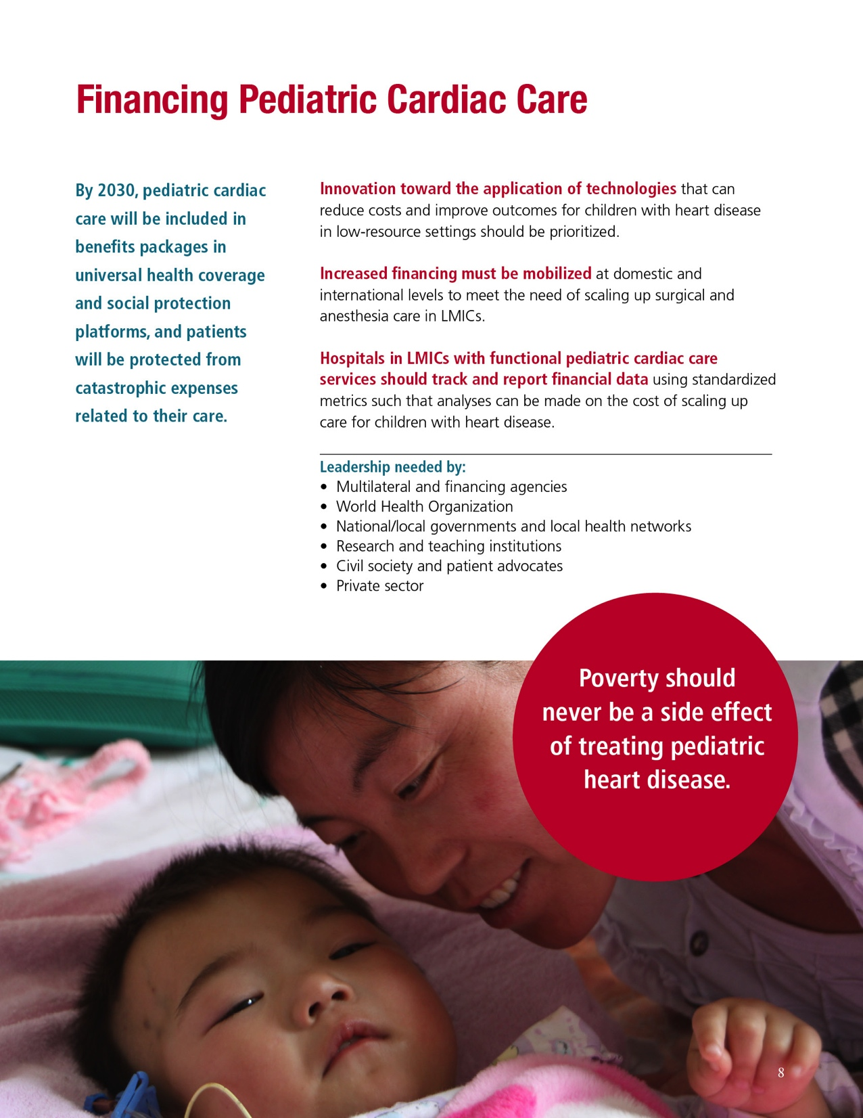
Notes:
And pediatric cardiac care must be included in benefits packages so that poverty is never a side effect of treating pediatric heart disease.
It is our decision, collectively, whether children with heart disease will be among the child deaths we failed to prevent, or if these children are allowed their right to health.
Please help us spread the word about The Invisible Child.
This series can be downloaded at theinvisiblechild.childrensheartlink.org
Thank you.

